Slide 1
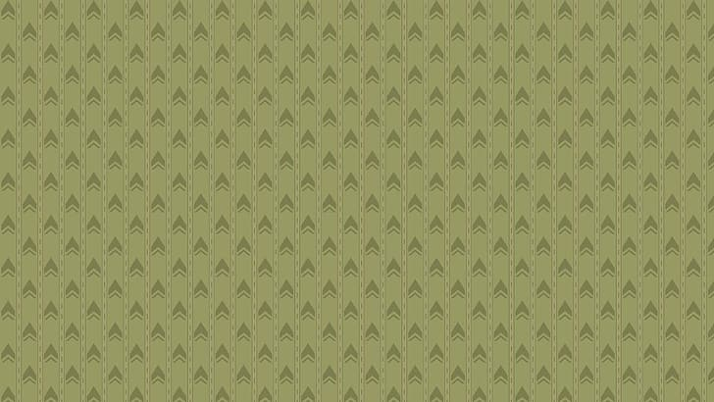
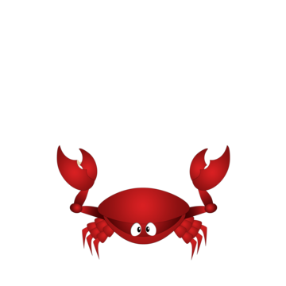
Inside the Crabrooms - Results
Deryn, Hannah, Sophie

Slide 2
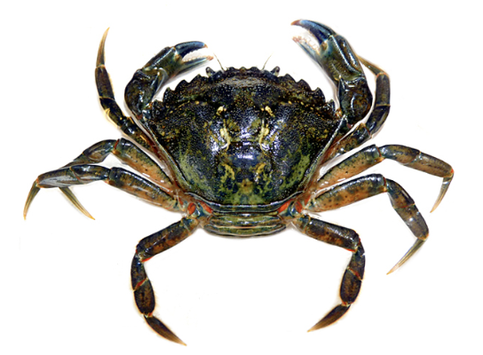
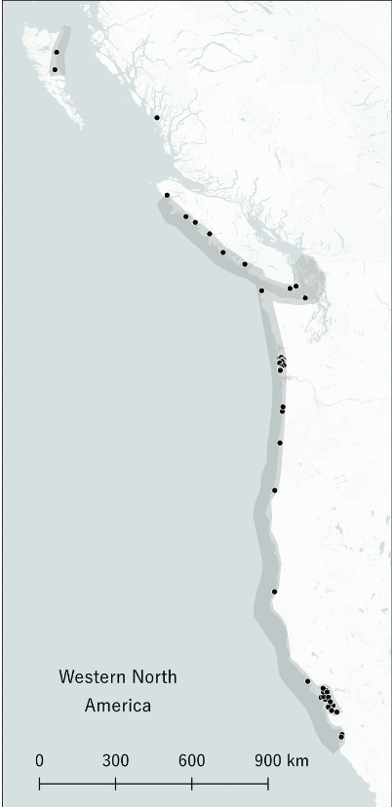
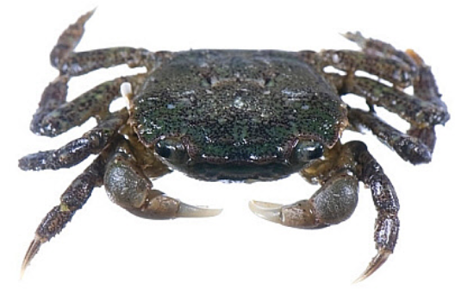

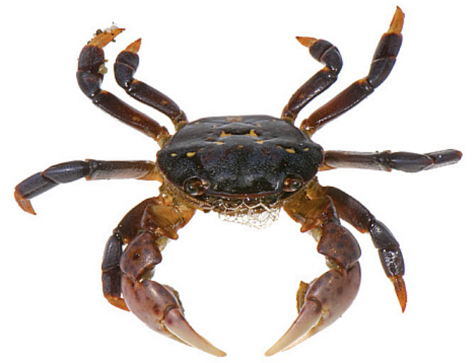
Background
European Green Crabs (Carcinus maenas) are one of the top 100 worst invasive species (Ens et al., 2022)
Native shore crab species at threat due to EGC invasion
Hemigrapsus oregonensis
Hemigrapsus nudus
European Green Crab
Hairy Shore Crab
Purple Shore Crab
Notes:
DERYN
Invaded both Atlantic and Pacific North American Oceans from eastern shores of Europe
They are generalists and are Extremely tolerant to environmental change
Predator: Eats smaller native crabs and other types of small fish
Competitor: Outcompetes other crabs in the area for food and shelter
Habitat disruptor: Digs up eelgrass beds and causes erosure to intertidal seabeds due to their burrowing and feeding habitats
Also damages bivalve fisheries
shore crabs are native to PNW and has a very similar range and niche the the european green crabs

Slide 3
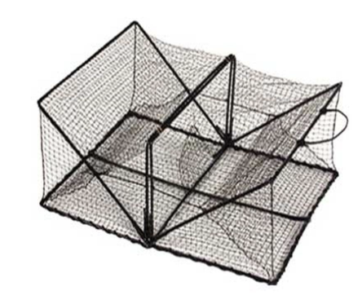
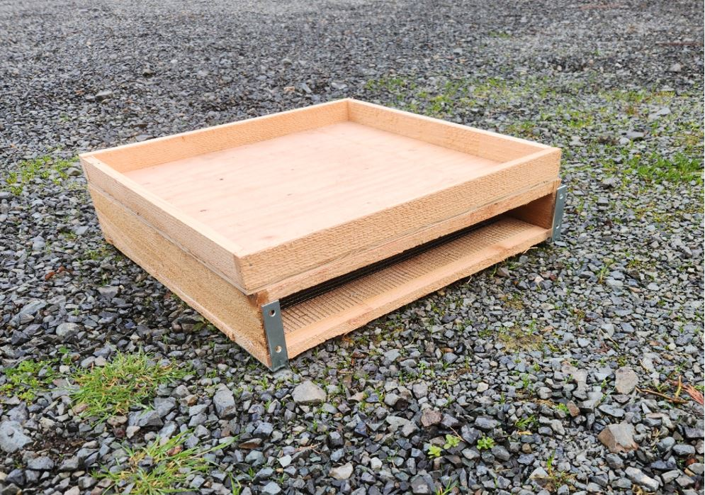
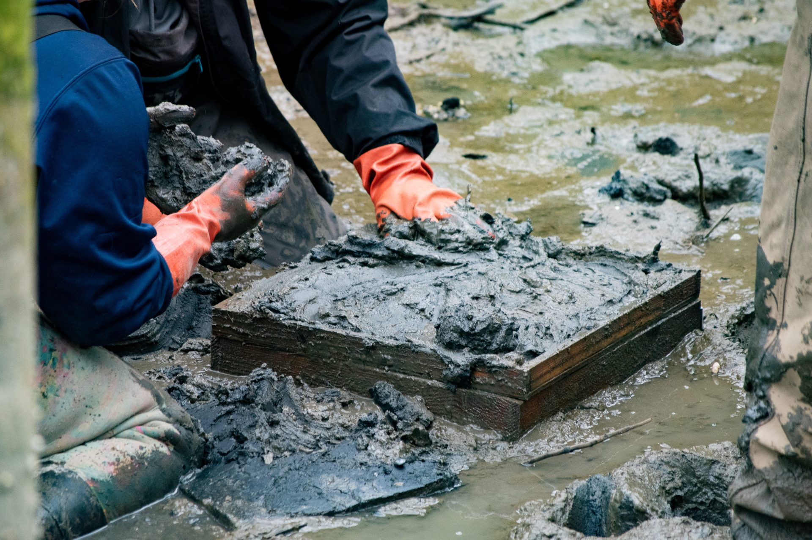
Background
Most commonly used control efforts is trapping (Ens et al., 2022)
Fukui traps
Crab slab
Innovative “trap” being tested by the Tulalip tribe (Cauvel, 2024)
Lots of bycatch in trapping efforts
Traps cause behavioral and reproductive changes on captured species (Darnell et al., 2010)
Fukui Trap
Crab Slab: NW Treaty Tribes
Notes:
DERYN
Green crabs were only introduced to puget sound in 2010 so there is a possibility of containment if we act fast
Fukui traps
Funnel like shape that crabs climb into and get trapped in
Crab slab
Less of a trap and more of a simulated natural habitat designed to lure in European Green crabs for capture
Native crabs end up as bycatch in both of these traps
Although there is studied effects on behavior and reproductive changes there is almost no research into the stress response of these captured crabs
General changes to stress and metabolic baseline can effect growth, lifestyle, and population status of native shore crabs
For this reason, we hope to fill this knowledge gap with our experiment

Slide 4
Research Question:
How do different simulated crab traps conditions affect the stress response of native shore crabs Hemigrapsus oregonensis?
H₀: There is no change in stress in Hemigrapsus oregonensis when in a simulated classic trap compared to simulated natural traps with or without Carcinus maenas exposure.
H_{A}: There is a change in stress in Hemigrapsus oregonensis when in a simulated classic trap compared to simulated natural traps with or without Carcinus maenas exposure.
H_{A1} : Classic traps induce a higher stress response in Hemigrapsus oregonensis.
H_{A2} : Presence of Carcinus maenas induces a higher stress response in Hemigrapsus oregonensis.
Notes:
HANNAH
We are testing two main variables. 1. The natural trap which mimics the crab slab environment and the classic trap which mimics the Fukui trap 2. Whether or not there is a stress response in hemigrapsus when forced to be in the presence of carcinus
Our predicted responses are that the simulated classic trap and the presence of carcinus will cause a higher stress response compared to the simulated native trap and no green crab presence

Slide 5
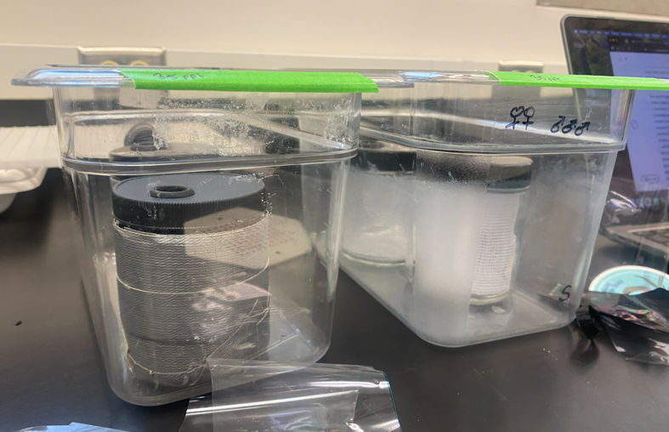
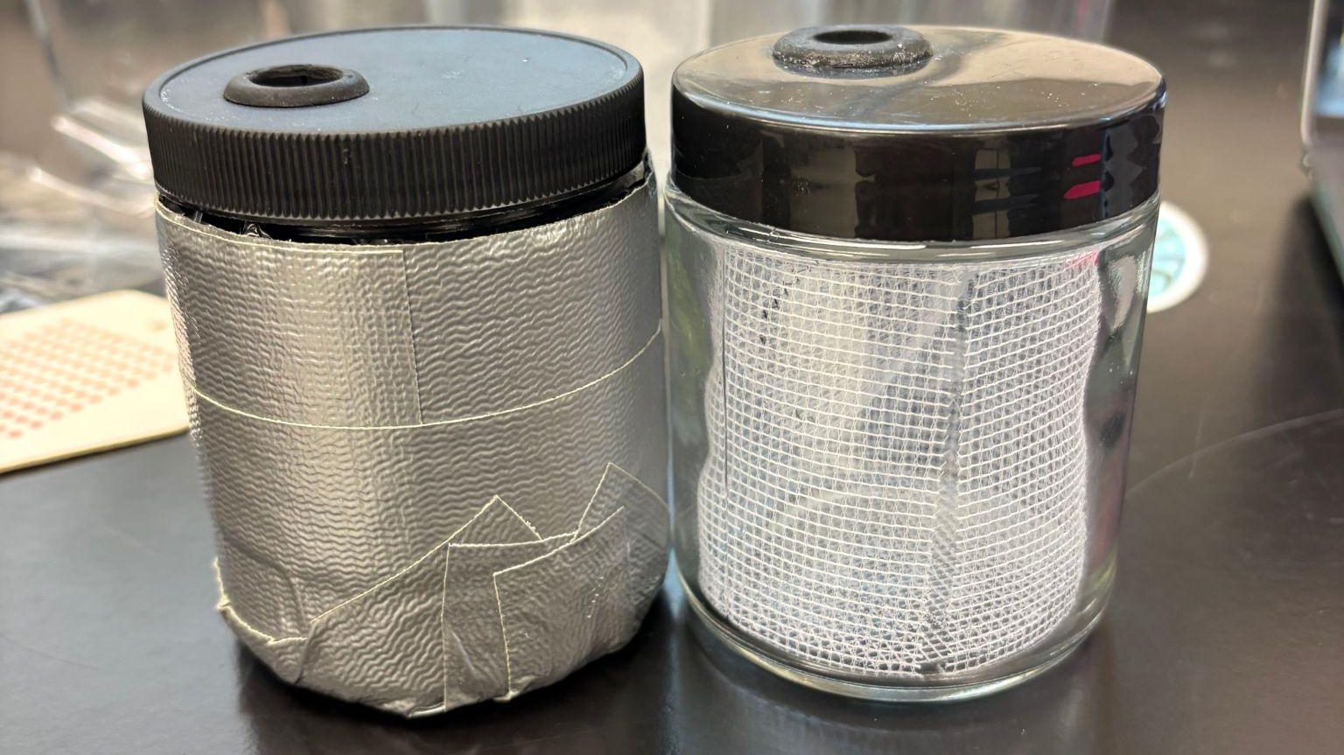
Experimental Design
Variables
Respiration
Righting time (Schroeder-Spain et al. 2018)
Hemolymph extraction → total protein assay
Notes:
HANNAH
Trap type
Classic fukui trap or natural “crab slab”
Full pots do not fit within the confines of this experiment
Simulate the habitat the pots create within the bins
Crab species
Hemigrapsus oregonensis by itself or in the presence of Carcinus maenas
Each week (x3):
Measure righting time of each shore crab
Sample water and perform resazurin assay: 0 min, 30 min, and 60 min for each bin -> measure respiration rate
Final week:
Protein assay with hemolymph extraction

Slide 6
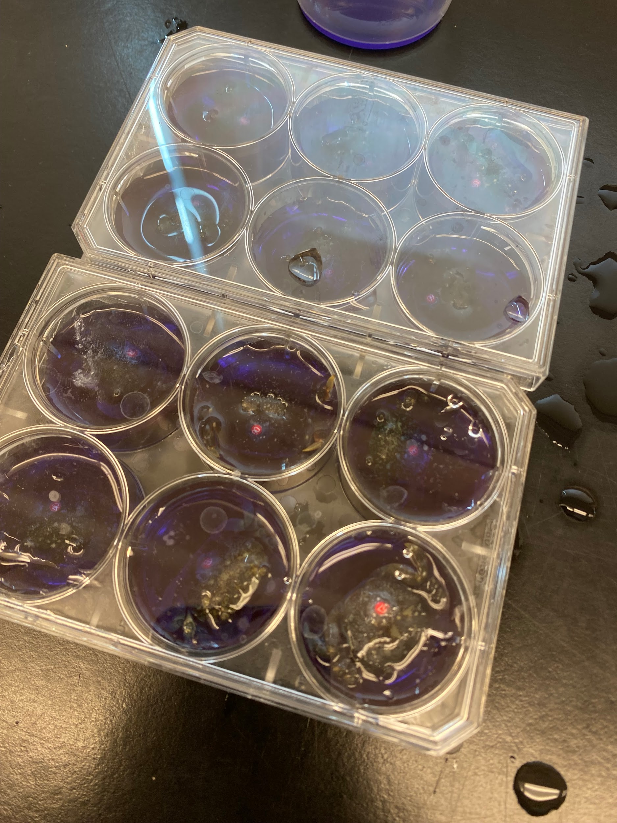
Overall results
There was no significant difference is overall stress response across treatments.
Notes:
SOPHIE
these are arbitrary y axis values

Slide 7
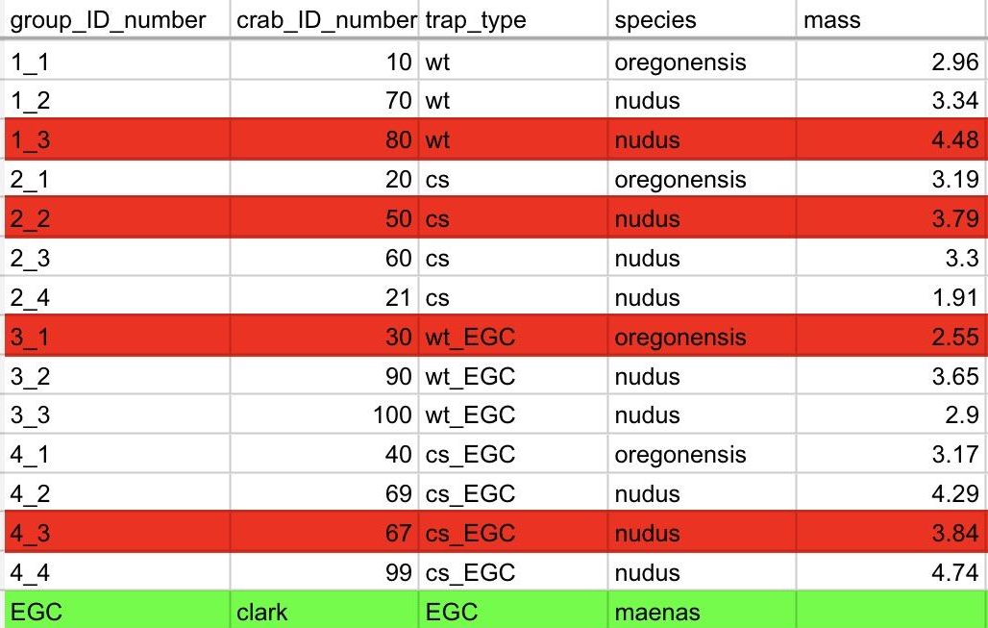
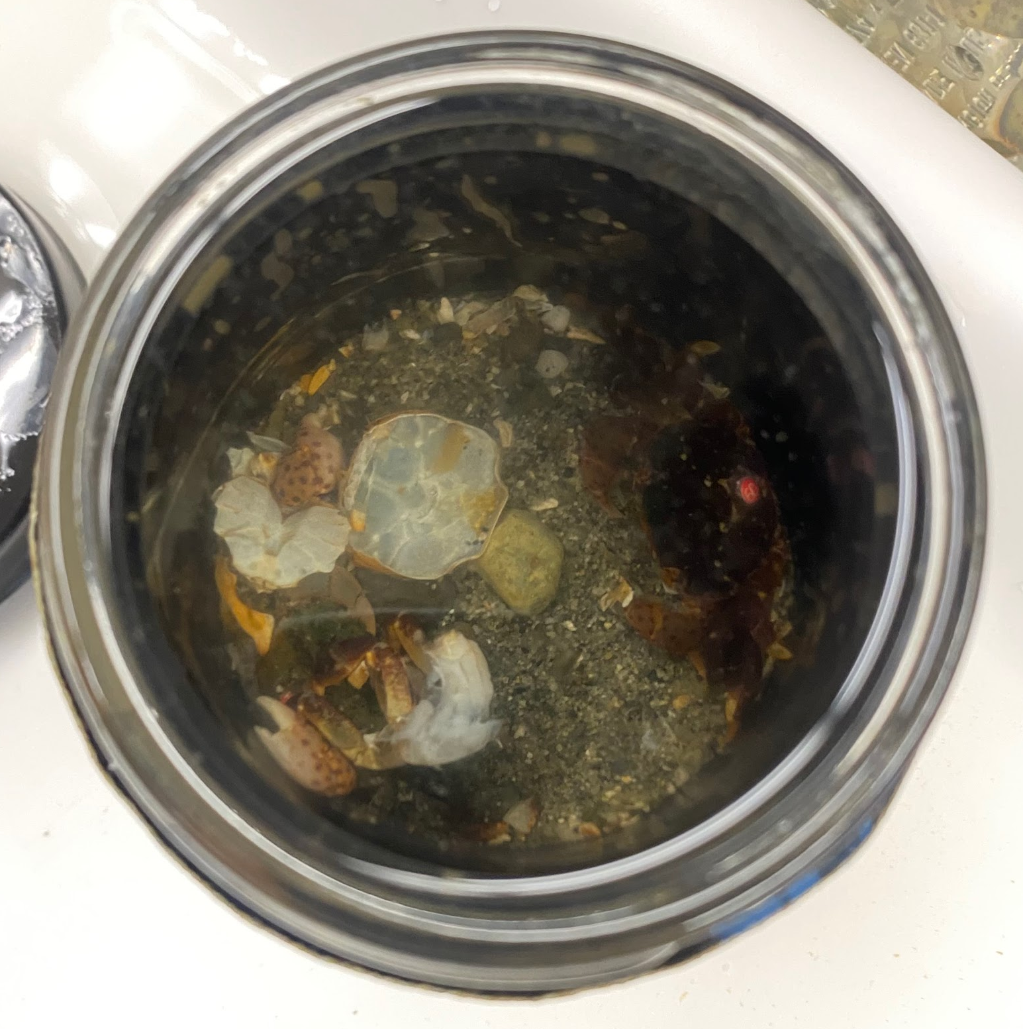
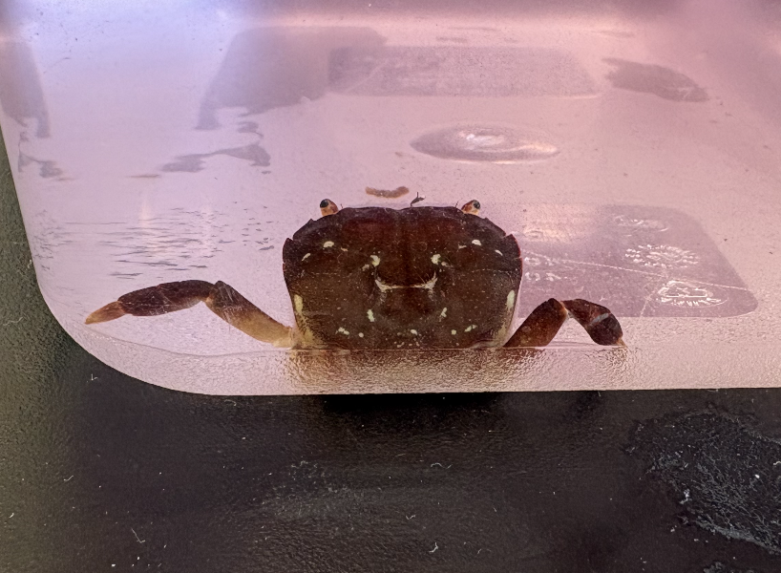
Observations / Crab statuses
Molts: 10, 80
Missing limbs: 10, 80, 50
Mortalities: 80, 50, 30, 67
Replacements:
67: nudus 3.84g -> 99: nudus 4.74g
50: nudus 3.78g -> 21: nudus 1.91g
Mortalities by Lab:
Week 1: Wire trap + EGC (x1)
Week 2: Crab slab + EGC (x1)
Week 3: Crab slab, Wire trap (x2)
Notes:
SOPHIE

Slide 8
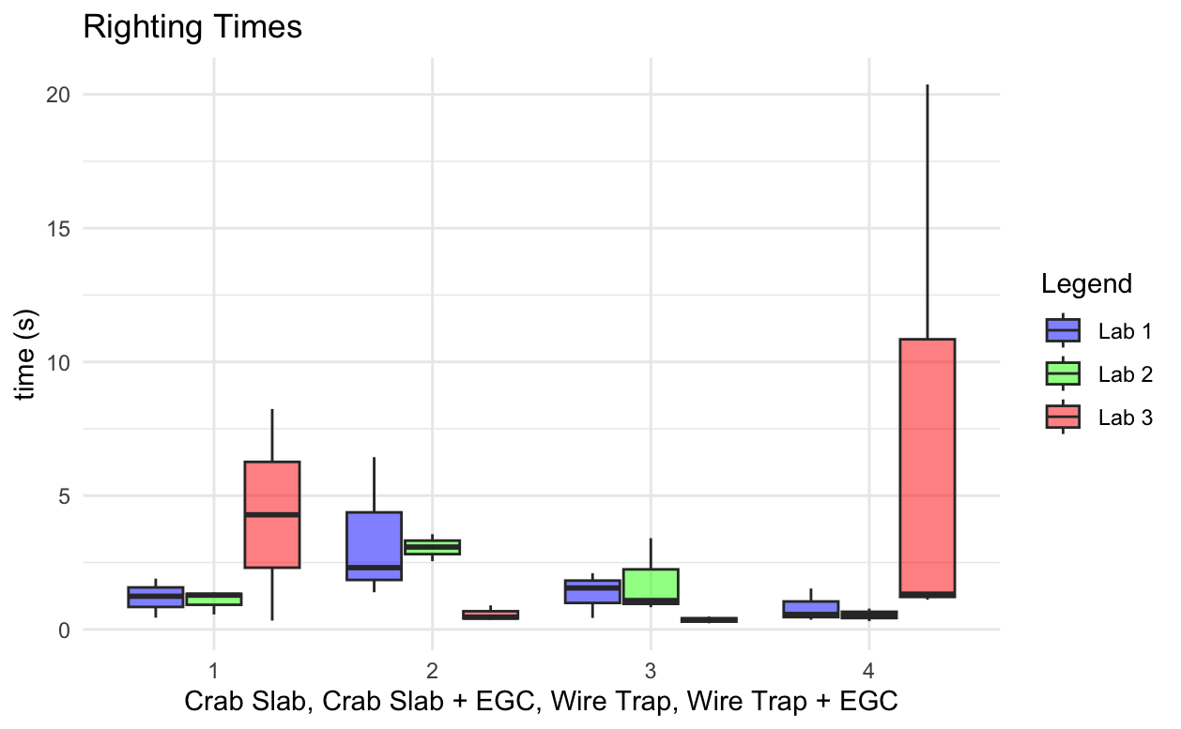
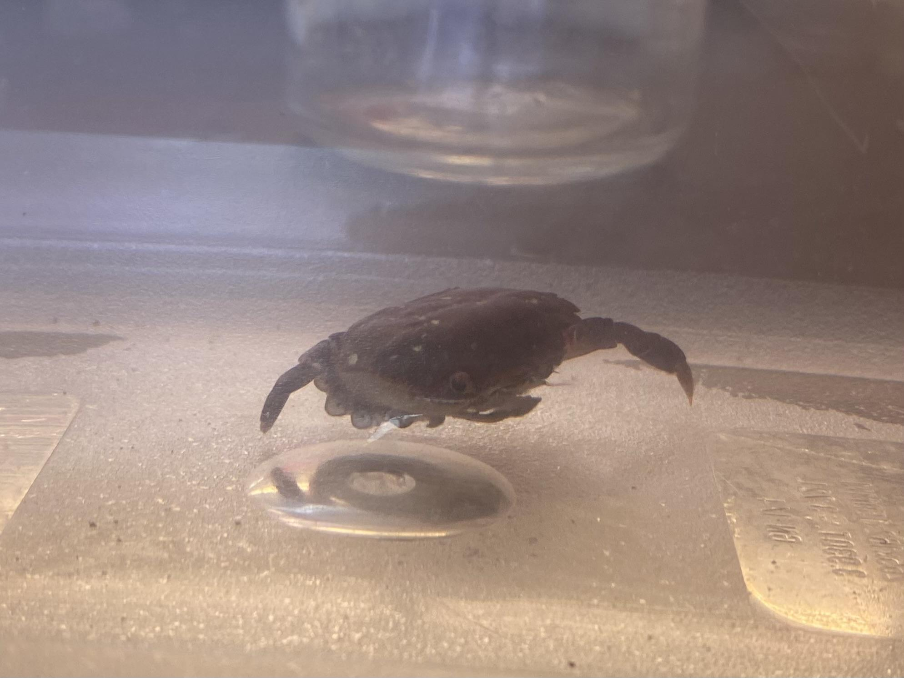
Righting time results
Kruskal-Wallis by treatment: p-value = 0.4704
By time and treatment: p-value 0.1143
W/o outlier of (20 secs) by treatment: p-value = 0.2588
Important to note: gaps in righting time data due to mortalities and replacements
8.24 seconds !!
Notes:
SOPHIE

Slide 9
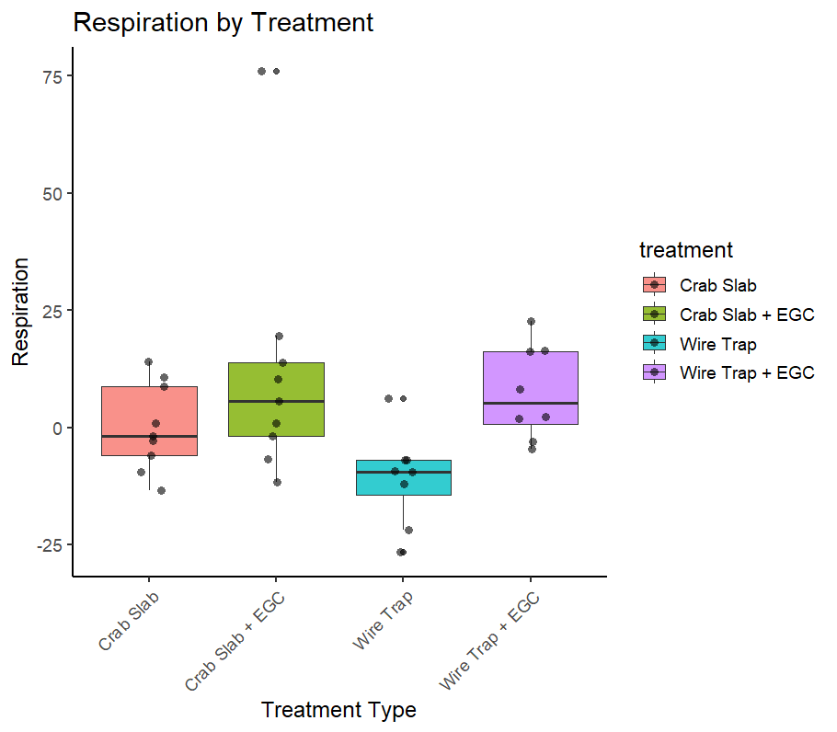
Respiration results
No significant difference across treatments
p = 0.467
Difference in respiration per treatment (t60 - t0) across all three weeks
Notes:
HANNAH

Slide 10
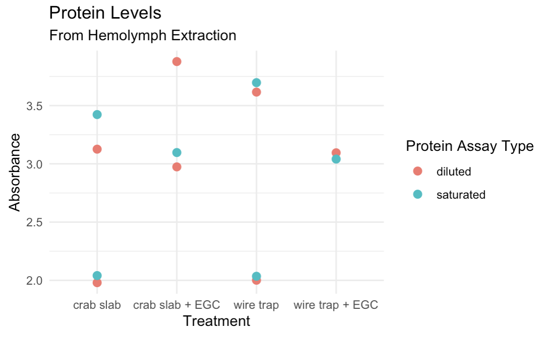
Protein Levels
From hemolymph extraction
Not enough data to predict correlations
Similarity between protein levels across predator treatments
Possible that it was skewed by starvation (Mente et al., 2010)
This figure shows protein absorbance from hemolymph extractions over the different treatments. Colors represent different assay types. Each combination of two assay types shows individual crabs. Overflows were omitted from the data and considered to be N/A. P-value = 0.838
Notes:
DERYN
Energy expenditure
Less protein = using more energy because they are more stressed

Slide 11
Application
Aids in the capture and removal efforts of green crabs in the PNW by better understanding how these efforts are affecting native species.
Decreasing excess stress on native crabs is beneficial to decreasing the anthropogenic side effects of green crab removal efforts.
Notes:
DERYN

Slide 12
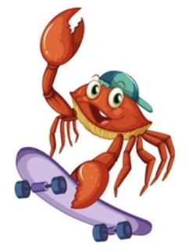
Future Directions
Running trials in real traps
Testing in wild conditions
More trap types
Longer trials
Determine if there are chronic effects
Notes:
HANNAH

Slide 13
Sources
Archdale, M. V., Añasco, C. P., Kawamura, Y., & Tomiki, S. (2007). Effect of two collapsible pot designs on escape rate and behavior of the invasive swimming crabs Charybdis japonica and Portunus pelagicus. Fisheries Research, 85(1), 202–209. https://doi.org/10.1016/j.fishres.2007.02.008
Cauvel, K. (2024, June 19). Tribes test innovative trap in battle against invasive crab. Northwest Treaty Tribes. https://nwtreatytribes.org/tribes-test-innovative-trap-in-battle-against-invasive-crab/
Darnell, M. Z., Darnell, K. M., McDowell, R. E., & Rittschof, D. (2010). Postcapture Survival and Future Reproductive Potential of Ovigerous Blue Crabs Callinectes sapidus Caught in the Central North Carolina Pot Fishery. Transactions of the American Fisheries Society, 139(6), 1677–1687. https://doi.org/10.1577/T10-034.1
Ens, N. J., Harvey, B., Davies, M. M., Thomson, H. M., Meyers, K. J., Yakimishyn, J., Lee, L. C., McCord, M. E., & Gerwing, T. G. (2022). The Green Wave: Reviewing the environmental impacts of the invasive European green crab (Carcinus maenas) and potential management approaches. Environmental Reviews, 30(2), 306–322. https://doi.org/10.1139/er-2021-0059
Mente, E. “Protein Nutrition in Crustaceans.”CABI Reviews, Nov. 2006. DOI.org (Crossref), https://doi.org/10.1079/PAVSNNR20061043.
Schroeder-Spain K, Fisher LL, Smee DL (2018) Uncoordinated: Effects of sublethal malathion and carbaryl exposures on juvenile and adult blue crabs (Callinectes sapidus). J Exp Mar Biol Ecol 504:1–9. https://doi.org/10.1016/j.jembe.2018.03.005
Tummon Flynn, P., Poirier, L. A., Beaulieu, G., Barrett, T. J., Cairns, D. K., & Quijón, P. A. (2024). On the rebound: Removal programs yield local-scale benefits but do not sustainably suppress populations of invasive European green crabs (Carcinus maenas). Biological Invasions, 26(2), 451–469. https://doi.org/10.1007/s10530-023-03183-4

Slide 14
Thank you for listening to our presentation!!!
Questions?
Please approve :)

